Slide 1
DBMS MINI PROJECT
~Deepika S Mathpati(3PD24CS053)
~Anam Fatima(3PD24CS023)

Slide 2
introduction
A Crime Data Analysis System is a database management application designed to store, manage, and analyze crime-related information efficiently. Law enforcement agencies handle large volumes of crime records, criminal details, case information, and investigation reports. Managing this data manually is difficult and time-consuming.
Using a DBMS, crime-related data can be stored securely, retrieved quickly, and analyzed effectively. The system helps authorities identify crime patterns, monitor criminal activities, and improve decision-making.
Key Features
Centralized crime database
Criminal record management
Case tracking
Crime pattern analysis
Quick data retrieval
Improved public safety

Slide 3
Crime Data Analysis System
The proposed system is designed to maintain crime records and provide meaningful analysis of crime data. It stores information about crimes, criminals, police officers, locations, and case status in a structured database.
Instead of maintaining paper records, the system allows police departments to access information instantly. Crime statistics can be generated using SQL queries to identify high-crime areas, common crime types, and solved or unsolved cases.
Objectives
Store crime information efficiently
Maintain criminal records
Track investigation status
Analyze crime trends
Generate statistical reports
Support decision-making for law enforcement

Slide 4
SQL Code for table creation
CREATE DATABASE CrimeDB; USE CrimeDB; CREATE TABLE Criminal( Criminal_ID INT PRIMARY KEY, Name VARCHAR(50), Age INT, Gender VARCHAR(10) ); CREATE TABLE Location( Location_ID INT PRIMARY KEY, Area VARCHAR(50), City VARCHAR(50) ); CREATE TABLE Police( Officer_ID INT PRIMARY KEY, Officer_Name VARCHAR(50), Station VARCHAR(50) );
CREATE TABLE Crime( Crime_ID INT PRIMARY KEY, Crime_Type VARCHAR(50), Crime_Date DATE, Crime_Time TIME, Location_ID INT, Criminal_ID INT, FOREIGN KEY(Location_ID) REFERENCES Location(Location_ID), FOREIGN KEY(Criminal_ID) REFERENCES Criminal(Criminal_ID) ); CREATE TABLE Cases( Case_ID INT PRIMARY KEY, Status VARCHAR(30), Crime_ID INT, Officer_ID INT, FOREIGN KEY(Crime_ID) REFERENCES Crime(Crime_ID), FOREIGN KEY(Officer_ID) REFERENCES Police(Officer_ID) );

Slide 5
SQL CODE FOR VALUE INSERTION
INSERT INTO Criminal VALUES
(1,'Ramesh',30,'Male'),
(2,'Suresh',25,'Male'),
(3,'Priya',28,'Female');
INSERT INTO Location VALUES
(101,'Whitefield','Bangalore'),
(102,'Electronic City','Bangalore'),
(103,'Marathahalli','Bangalore');
INSERT INTO Police VALUES
(201,'Raj Kumar','Whitefield Station'),
(202,'Anita Rao','Electronic City Station');
INSERT INTO Crime VALUES
(1001,'Theft','2026-01-10','10:30:00',101,1),
(1002,'Robbery','2026-01-12','18:00:00',102,2),
(1003,'Fraud','2026-01-15','12:15:00',103,3);
INSERT INTO Cases VALUES
(301,'Solved',1001,201),
(302,'Pending',1002,202),
(303,'Under Investigation',1003,201);

Slide 6
Queries and Output
QUERY 1
SELECT Crime_Type, COUNT(*) AS Total_Cases
FROM Crime
GROUP BY Crime_Type;
QUERY 2
SELECT Area, COUNT(*) AS Crime_Count
FROM Crime C
JOIN Location L
ON C.Location_ID=L.Location_ID
GROUP BY Area;
Crime_Type | Total_Cases
Theft | 2
Robbery | 1
Fraud | 1
Area | Crime_Count
Whitefield | 2
Electronic City | 1
Marathahalli | 1

Slide 7
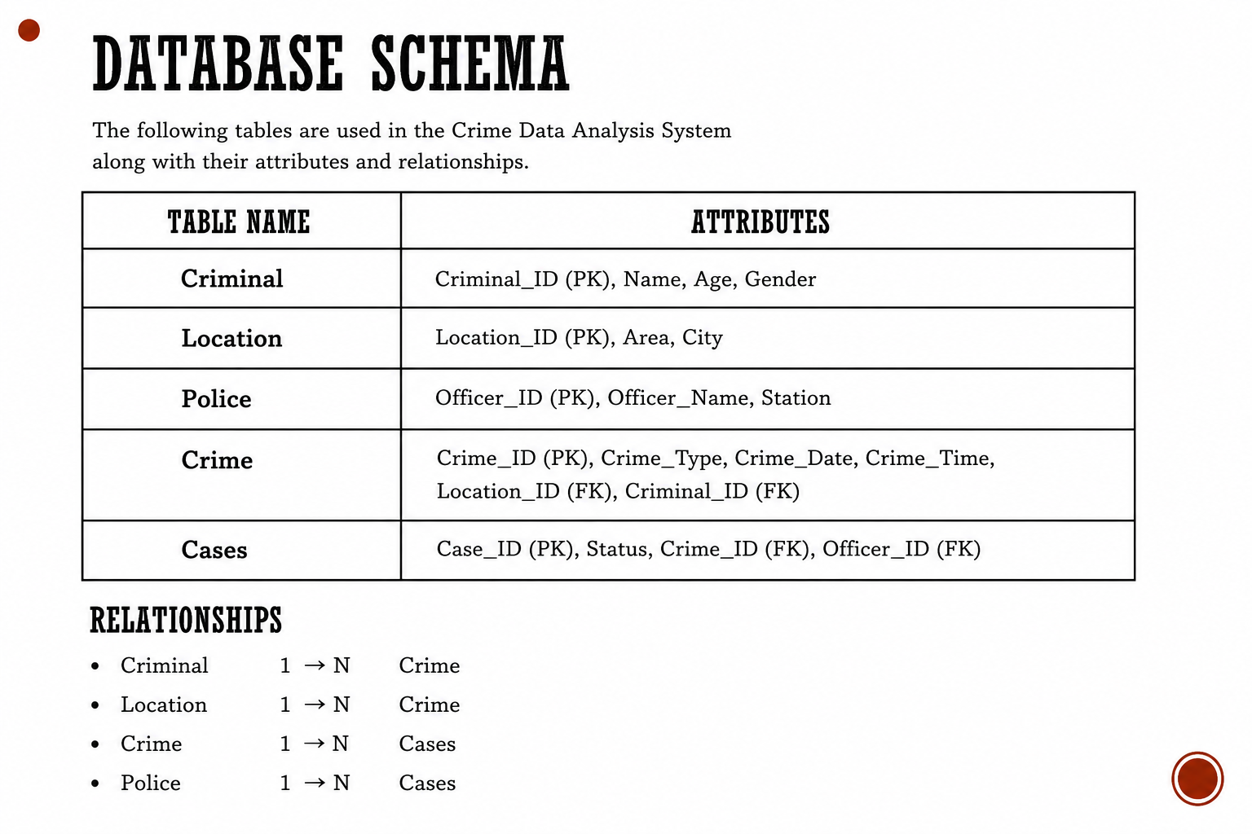

Slide 8
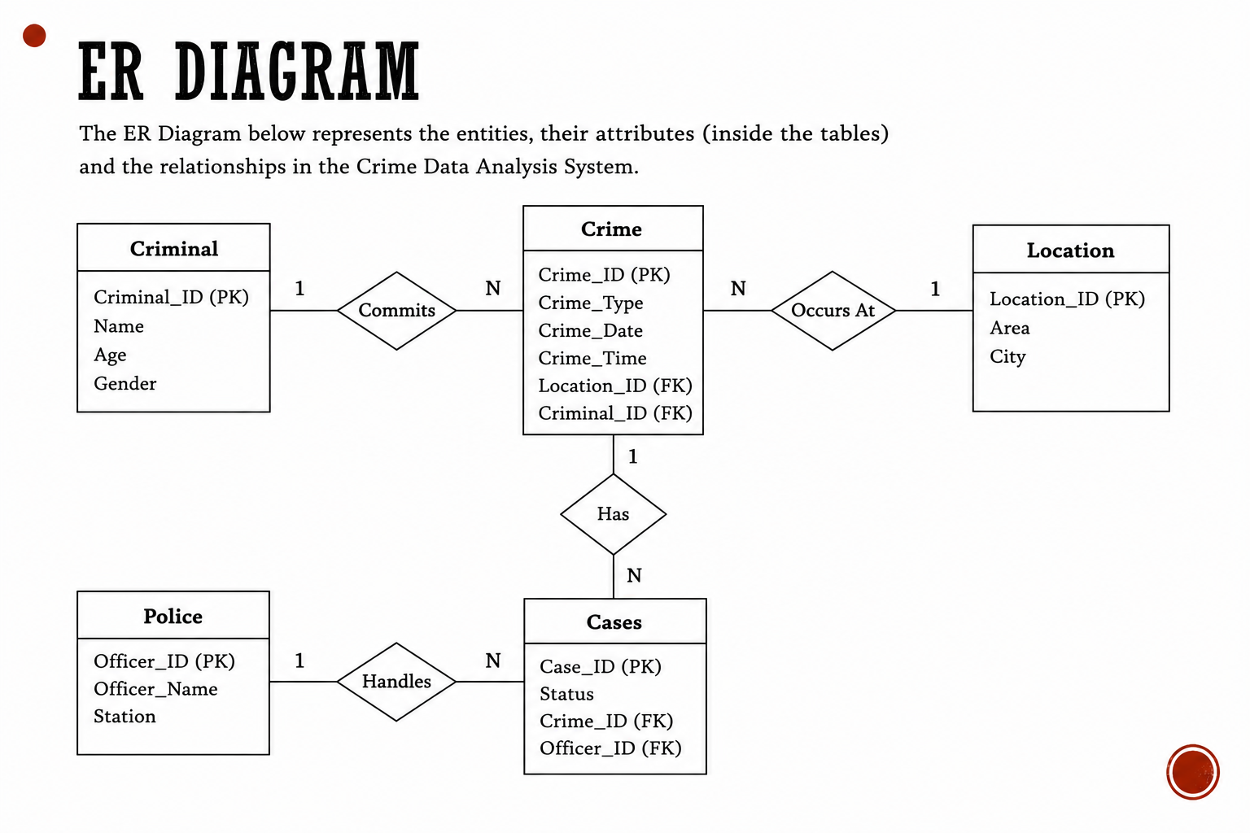

Slide 9
conclusion
The Crime Data Analysis System demonstrates how a Database Management System can be used to efficiently store, organize, and analyze crime-related information. The system improves record management, supports investigation processes, and helps identify crime patterns through SQL-based analysis.
Future Scope
Crime prediction using Machine Learning
Real-time crime monitoring
GIS-based crime mapping
Mobile application integration
Automated alert generation
Thank You

